Slide 1
MICROWAVE TUBES
Source for the generation of normal microwave power signals are classified mainly into categories:
1- Microwave Tubes :-
klystron, reflex klystron, magnetron and TWT. 2- Diode semiconductor :
Tunnel, Gunn, Impatt, Varactor diodes, PIN, Schottky barrier diode.
MICROWAVE TUBES
Used for high power/high frequency combination.
Tubes generate and amplify high levels of microwave power more cheaply than solid state devices.
Conventional tubes can be modified for low capacitance but specialized microwave tubes are also used.
CROSSED-FIELD AND LINEAR-BEAM TUBES
Klystrons and Traveling-Wave tubes are examples of linear-beam tubes
These have a focused electron beam (as in a CRT)
Magnetron is one of a number of crossed-field tubes
Magnetic and electric fields are at right angles
KLYSTRON
A klystron is a vacuum tube that can be used either as a generator or as an amplifier of power, at microwave frequencies.

Slide 2
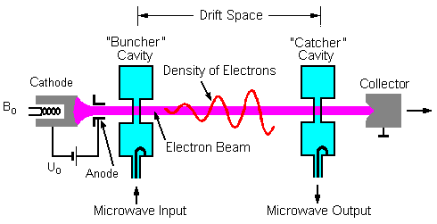
There are two basic configurations of klystron tubes
Reflex Klystron used as a low-power Microwave oscillator
Multi cavity klystron used as low-power microwave amplifier
Multi cavity klystron
Used in high-power amplifiers
It is referred to as a linear beam tube because the direction of the electric field that accelerates the electron beam coincides with the axis of the magnetic field, in contrast to a crossed field tube such as a magnetron.
Electron beam moves down tube past several cavities.
Input cavity is the buncher, output cavity is the catcher.
Buncher modulates the velocity of the electron beam
Two cavity klystron amplifier
Operation:
Velocity modulated tube
High velocity electron beam is generated by an electron gun and sent down along a gas tube through an input cavity (BUNCHER), drift space (FIELD FREE) and an output cavity (CATCHER) to a collector electrode anode.

Slide 3
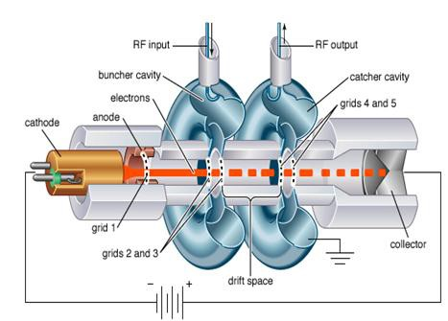
The anode is kept positive to receive the electrons, while the output is taken from the tube via resonant cavities with the aid of coupling loops
Two grids of the buncher cavity are separated by a small gap A while the two grids of the catcher cavity are separated by a small gap B.
Operation:
The input buncher cavity is excited by the RF signal, (the signal to be amplified) which will produce an alternating voltage of signal frequency across the gap A.
This voltage generated at the gap A is responsible to produce bunching of electrons or velocity modulation of the electron beam.
Applications of klystron
As power output tubes
in UHF TV transmitters
in troposphere scatter transmitters
satellite communication ground station
radar transmitters

Slide 4
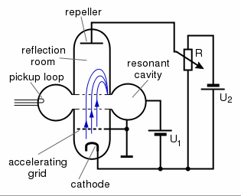
As power oscillator (5 – 50 GHz), if used as a klystron oscillator
Reflex Klystrons
The reflex klystron has been the most used source of microwave power in laboratory applications.
Single Re-entrant cavity as a resonator.
The electron beam emitted from the cathode is accelerated by the grid and passes through the cavity anode to the repeller space between the cavity anode and the repeller electrode .
The feedback required to maintain the oscillations within the cavity is obtained by reversing electron beam emitted from the cathode towards repeller electrode and sending it back through the cavity.
The electrons in the beam are velocity modulated before the beam passes through the cavity the second time and give up the energy to the cavity to maintain oscillations.
This type of a Klystron is called a Reflex Klystron because of the reflex action of the electron beam.
Reflex klystron

Slide 5
Performance Characteristics
Frequency: 4 – 200 GHz
Power: 1 mW – 2.5 W
Theoretical efficiency : 22.78 %
Practical efficiency : 10 % - 20 %
Tuning range : 5 GHz at 2 W – 30 GHz at 10 mW
Applications
The reflex klystrons are used in
Radar receivers
Local oscillator in microwave receivers
Signal source in microwave generator of variable frequency
Portable microwave links
Pump oscillator in parametric amplifier
Mechanism of Oscillation
It is assumed that the oscillations are set up in the tube initially due to noise or switching transients and the oscillations are sustained by device operation.
The electrons passing through the cavity gap d experience this RF field and are velocity modulated.
(Operation )
The electrons B which encountered the positive half cycle of the RF field in the cavity gap d will be accelerated, A which encountered zero RF field will pass with unchanged original velocity, and c which encountered the negative half cycle will be retarded on entering the repeller space.

Slide 6
All these velocity modulated electrons will be repelled back to the cavity by the repeller due to the negative potential.
The repeller distance L and the voltages can be adjusted to receive all the electrons at a same time on the positive peak of the cavity RF velocity cycle.
Thus the velocity modulated electrons are bunched together and lose their kinetic energy when they encounter the positive cycle of the cavity RF field.
The electrons B which encountered the positive half cycle of the RF field in the cavity gap d will be accelerated, A which
encountered zero RF field will pass with unchanged original
velocity, and c which encountered the negative half cycle will be retarded on entering the repeller space.
All these velocity modulated electrons will be repelled back to the
cavity by the repeller due to the negative potential.
Mode of Oscillation
The electrons should return after 1¾, 2 ¾ or 3 ¾ cycles – most optimum departure time.
If T is the time period at the resonant frequency, t_{o} is the time taken by the reference electron to travel in the repeller space between entering the repeller space and returning to the cavity at positive peak voltage on formation of the bunch
Then, t_{o} = (n + ¾)T = NT
Where N = n + ¾, n = 0,1,2,3…….
N – mode of oscillation.
The mode of oscillation is named as N = ¾, 1 ¾ modes n = 0,1,2……resp.
2 ¾ etc for

Slide 7
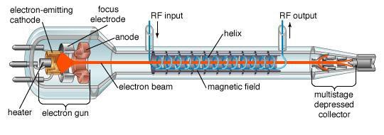
TRAVELING-WAVE TUBE (TWT)
Traveling Wave Tube (TWT) is the most versatile microwave RF power amplifiers.
The main virtue of the TWT is its extremely wide band width of operation.
Traveling- wave Tube (TWT)
Basic structure
The basic structure of a TWT consists of a cathode and filament heater plus an anode that is biased positively to accelerate the electron beam forward and to focus it into a narrow beam.
The electrons are attracted by a positive plate called the collector, which has given a high dc voltage.
The length of the tube is usually many wavelengths at the operating frequency.
Surrounding the tube are either permanent magnets or electromagnets that keep the electrons tightly focused into a narrow beam.

Slide 8
Features
The unique feature of the TWT is a helix or coil that surrounds the length of the tube and the electron beam passes through the centre or axis of the helix.
The microwave signal to be amplified is applied to the end of the helix near the cathode and the output is taken from the end of the helix near the collector.
The purpose of the helix is to provide path for RF signal.
The propagation of the RF signal along the helix is made approximately equal to the velocity of the electron beam from the cathode to the collector .
Functioning
The passage of the microwave signal down the helix produces electric and magnetic fields that will interact with the electron beam.
The electromagnetic field produced by the helix causes the electrons to be speeded up and slowed down, this produces velocity modulation of the beam which produces density modulation.
Density modulation causes bunches of electrons to group together one wavelength apart and. these bunch of electrons travel down the length of the tube toward the collector.
The electron bunches induce voltages into the helix which reinforce the voltage already present there. Due to that the strength of the electromagnetic field on the helix increases as the wave travels down the tube towards the collector.
At the end of the helix, the signal is considerably amplified.
Coaxial cable or waveguide structures are used to extract the energy from the helix.

Slide 9
Advantages
TWT has extremely wide bandwidth. Hence, it can be made to amplify signals from UHF to hundreds of gigahertz.
Most of the TWT’s have a frequency range of approximately 2:1 in the desired segment of the microwave region to be amplified.
The TWT’s can be used in both continuous and pulsed modes of operation with power levels up to several thousand watts.
Performance characteristics
Frequency of operation : 0.5 GHz – 95 GHz
Power outputs:
5 mW (10 – 40 GHz – low power TWT) 250 kW (CW) at 3 GHz (high power TWT) 10 MW (pulsed) at 3 GHz.
3. Efficiency : 5 – 20 % ( 30 % with depressed collector)
Applications of TWT
Low noise RF amplifier in broad band microwave receivers.
Repeater amplifier in wide band communication links and long distance telephony.
Due to long tube life (50,000 hours against ¼th for other types), TWT is power output tube in communication satellite.
Continuous wave high power TWT’s are used in troposcatter links (due to larger power and larger bandwidths).
Used in Air borne and ship borne pulsed high power radars.

Slide 10
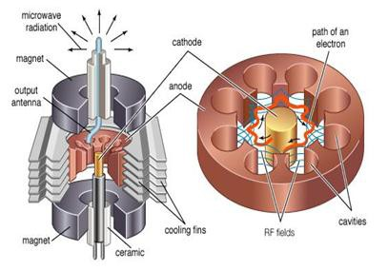
Magnetron
The magnetron is a high-powered vacuum tube that generates microwaves using the interaction of a stream of electrons with a magnetic field.
High-power oscillator
Common in radar and microwave ovens
Cathode in center, anode around outside
Strong dc magnetic field around tube causes electrons from cathode to spiral as they move toward anode
Current of electrons generates microwaves in cavities around outside
Operation
In a magnetron, the source of electrons is a heated cathode located on the axis of an anode structure containing a number of microwave resonators.
Electrons leave the cathode and are accelerated toward the anode, due to the dc field established by the voltage source E.

Slide 11
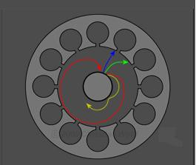
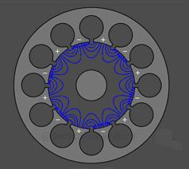
The presence of a strong magnetic field B in the region between cathode and anode produces a force on each electron which is mutually perpendicular to the dc field and the electron velocity vectors, thereby causing the electrons to spiral away from the cathode in paths of varying curvature, depending upon the initial electron velocity at the time it leaves the cathode.
As this cloud of electrons approaches the anode, it falls under the influence of the RF fields at the vane tips, and electrons will either be retarded in velocity, if they happen to face an opposing RF field, or accelerated if they are in the vicinity of an aiding RF field.
Since the force on an electron due to the magnetic field B is proportional to the electron velocity through the field, the retarded velocity electrons will experience less "curling force" and will therefore drift toward the anode, while the accelerated velocity electrons will curl back away from the anode .
The result is an automatic collection of electron "spokes" as the cloud nears the anode with each spoke located at a resonator having an opposing RF field.
On the next half cycle of RF oscillation, the RF field pattern will have reversed polarity and the spoke pattern will rotate to maintain its presence in an opposing field.
The high-frequency electrical field

Slide 12
MICROWAVE SOLID-STATE DEVICES (SEMICONDUCTOR DIODE)
Microwave semiconductor devices have been developed for various
applications.
Detection
Mixing
Frequency Multipliers
Attenuation
Switches, Limiters
Amplifiers and Oscillators.
Advantages:
Low cost
Small size
Less weight
High reliability
Employed in microwave integrated circuits.
Microwave semiconductor devices are classified into four groups: 1- Microwave bipolar junction transistor (BJT), hetero junction
bipolar transistor(HBT) and tunnel diodes.
Microwave field effect transistor like FET, JFET, MOSFET and high electron mobility transistor (HEMT).
Bulk effect of the semiconductor material which is referred to as " transferred electron devices". Like Gunn diode, limited space change accumulation device (LSA) device.
The effect of avalanche breakdown of semiconductor like Impact ionization avalanche transit time diode (IMPATT),Trapped plasma avalanche triggered transit diode (TRAPATT) and Barrier injected transit-time diodes (BARITT).

Slide 13
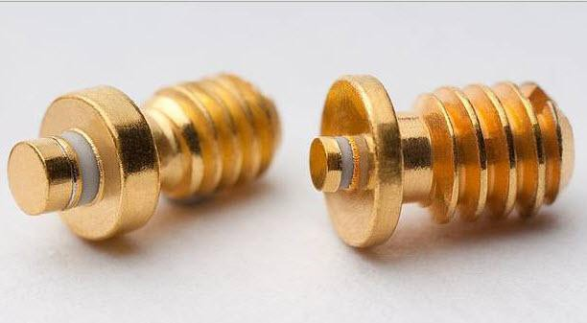
Gunn Diode
A Gunn diode, also known as a transferred electron device (TED), is a form of diode used in high-frequency electronics.
Its internal construction is unlike other diodes in that it consists only of N-doped semiconductor material, whereas most diodes consist of both P and N-doped regions.
In the Gunn diode, three regions exist: two of them are heavily N- doped on each terminal, with a thin layer of lightly doped material in between.
This means a Gunn diode has a region of negative differential resistance.
Applications
Because of their high frequency capability, Gunn diodes are mainly used at microwave frequencies and above.
They can produce some of the highest output power of any semiconductor devices at these frequencies.
Their most common use is in oscillators, but they are also used in microwave amplifiers to amplify signals.
Gunn diode oscillators are used to generate microwave power for 1- airborne collision avoidance radar ,
anti-lock brakes ,
sensors for monitoring the flow of traffic , 4- car radar detectors ,

Slide 14
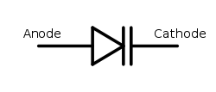
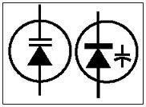
pedestrian safety systems ,
"distance traveled" recorders , 7- motion detectors,
Because of their high frequency capability, Gunn diodes are mainly
used at microwave frequencies and above.
They can produce some of the highest output power of any semiconductor devices at these frequencies.
Their most common use is in oscillators, but they are also used in
microwave amplifiers to amplify signals.
burglar alarms and equipment to detect trespassers, 12- sensors to avoid derailment of trains,
13- remote vibration detectors, 14- rotational speed tachometers,
15- moisture content monitors
Varactor Diode
A microwave solid-state device.
Also called a parametric diode, tuning diodes or varicap diodes.
A nonlinear device
Provides a voltage-dependent variable capacitance.

Slide 15
Types Of Varactor Diode
Abrupt and hyper abrupt type : When the changeover p-n junction is abrupt then it is called abrupt type. When change is very abrupt, they are called hyper abrupt type. They are used in oscillators to sweep for different frequencies.
Gallium-arsenide varactor diodes : The semiconductor material used is gallium arsenide. They are used for frequencies from 18 GHz up to and beyond 600 GHz.
Important Criteria
Capacitance : Capacitance of the device. Capacitance from a few picoFarads to hundreds of picoFarads is provided.
Capacitance range : Range of capacitance produced when voltage is varied.
Voltage range : The minimum and maximum voltage that can be applied to the device.
Bias current : The bias is always reverse. This means that the varactor diode does not conduct electricity. If the bias is turned positive then the device will start conducting
Other criteria to be considered include : reverse and breakdown voltage, leakage current, junction temperature.
Voltage and other transients must be avoided. Transients can occur if the DC voltage is put off.
Characteristics
Low-noise characteristic : produce much less noise than most conventional amplifiers.
Low cost
High reliability
Light weight
Small size

Slide 16
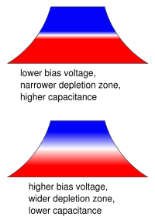
Operation
It has a p-n junction of semi-conducting material and is always reverse biased.
The depletion zone depends on the applied
Voltage and this makes the capacitance vary with the applied voltage.
Applications
FREQUENCY MULTIPLIERS - used in applications where it’s difficult to generate microwave signals.
Producing relatively high power outputs at frequencies up to 100GHz.
Does not have gain ; in fact, it produces a signal power loss,
Output can be as high as 80% of the input.
TUNING - Since the frequency can be made to vary they are used as electronic tuning devices in tuners for television, mobiles.
Other Applications: They are used in PLL, voltage controlled oscillators, harmonic generation, electronic tuning devices in tuners for television, mobiles, parametric amplification, AM radios, voltage-variable tuning, frequency multipliers, etc.

